Slide 1


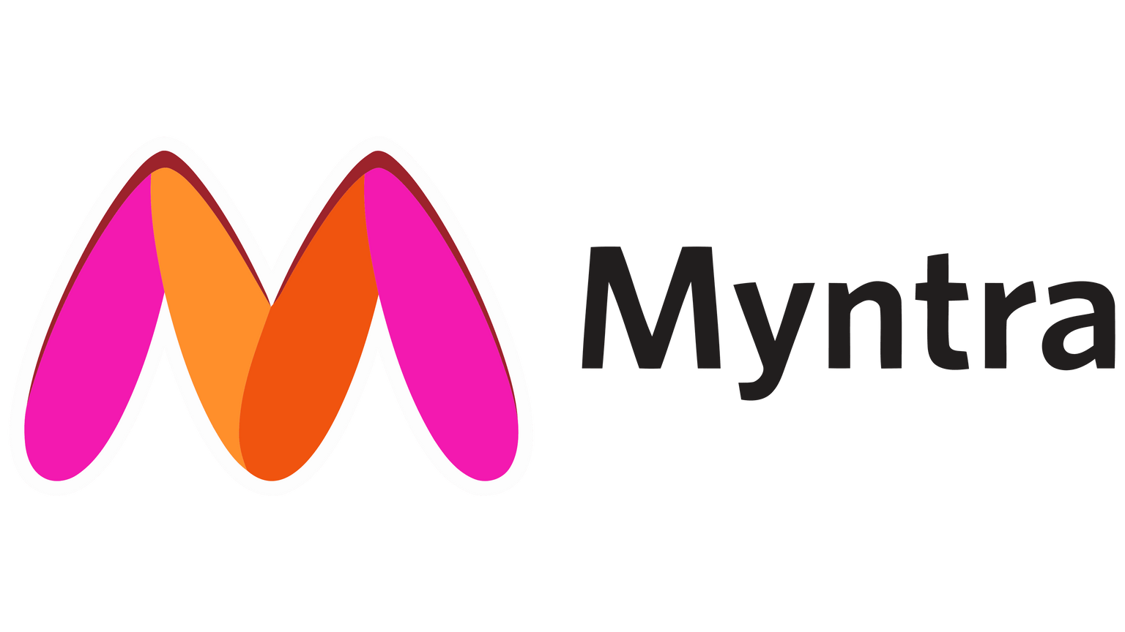
Myntra Analysis
TREND ANALYSIS

Slide 2
OBJECTIVE
Analyze Myntra’s brand perception.
Extract customer sentiments from social media and reviews.
Identify current fashion market trends.
Compare Myntra with key competitors.
Develop strategic recommendations for market improvement.

Slide 3



Brand Perception Analysis
Instagram serves as a major platform for product marketing for Myntra, with many influencers promoting Myntra products organically
Facebook focuses more on ads for festive sales and big discount events
X (formerly Twitter) is a hub for negative reviews, where active customers share their direct experiences with Myntra

Slide 4





Customer Sentiment Analysis
POSITIVE OUTCOME
Big fashion sales attract attention with targeted posters
Mega sales highlight specific categories for better visibility
Navaratri and fashion festival ads boost engagement
Influencers promote Myntra products with details, building credibility
Employee promotions increase brand loyalty and fan base

Slide 5





Customer Sentiment Analysis
NEGATIVE OUTCOME
Missing items and exchange issues frustrate customers
Delivery delays and changing dates impact trust
Fake customer care commitments worsen experience
Delayed cashback undermines promotional guarantees
Poor customer support adds to dissatisfaction

Slide 6
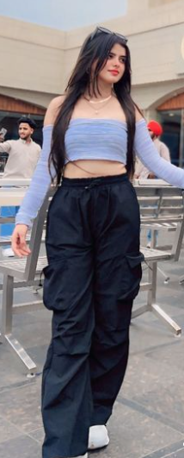



Tracking Fashion Trends
Oversized Clothing: Baggy jeans, hoodies, and relaxed fits are highly popular
Printed Fashion: Thrift-inspired and pattern styles are making a strong comeback
Fashionable and Functional: They prefer fashionable, functional clothing with bold colors and patterns
Fast Fashion Appeal: Affordable and quick to adapt to the latest trends

Slide 7

Competitive Landscape Assessment
AMAZON
X
Strengths
Trust and Reliability: Strong brand trust with fast delivery and customer-centric policies
Customer Service: Known for responsive and efficient customer service
Weaknesses
Fashion Identity: Seen as a general marketplace, not a dedicated fashion destination like Myntra
Less Fashion-Centric Marketing: Campaigns focus more on products than on fashion-lifestyle

Slide 8

Competitive Landscape Assessment
FLIPKART
X
Strengths
Aggressive Discount Campaigns: Flipkart runs frequent festive and seasonal sales, similar to Myntra
Partnership with Local Brands: Promotes Indian fashion brands, appealing to regional audiences
Weaknesses
Inconsistent Quality Reviews: Customers frequently report quality issues, which damages trust
Delayed Deliveries: Often criticized in customer reviews for late deliveries

Slide 9

Competitive Landscape Assessment
AJIO
X
Strengths
Strong Social Media Presence: Actively uses Instagram with influencers and style guides
AJIO Luxe: Offers premium fashion, giving it an advantage in the luxury segment
Weaknesses
Customer Service Issues: Frequently criticized for poor customer service and slow responses
Limited Variety: Smaller overall product variety compared to Myntra

Slide 10
Comparing Myntra with Competitors
Strengths
Strong fashion-centric brand: Highly recognized as a dedicated fashion platform with tailored marketing.
Wide influencer collaborations: Extensive use of influencers, driving organic engagement on platforms like Instagram.
Frequent sales and festive promotions: Known for its Big Fashion Sale, Navaratri Sale, and more.
Weaknesses
Customer service complaints: Issues like delivery delays, exchange problems, and poor customer support hurt its reputation.
Product quality issues: Customers occasionally report problems with missing items or quality mismatch.
Commitment failures: Negative reviews on platforms like X often mention fake commitments (e.g., cashback guarantees).

Slide 11



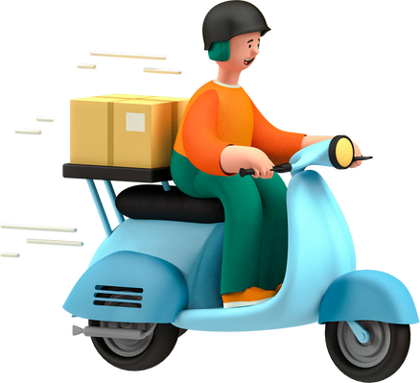


Strategic Recommendations
Enhance Customer Support
Ensure Cashback and Commitments
Streamline Delivery Process
Improve Exchange and Return System
Boost Product Quality Control

Slide 12
OVERALL SUMMARY
Brand perception fluctuates due to service and delivery issues.
Customer sentiment is mixed, with frequent negative feedback on support.
Myntra leverages fashion trends but struggles with consistency.
Competitors offer stronger service, but Myntra excels in marketing.
Strategic improvements needed in customer support and delivery logistics

Slide 13













SUBMITTED BY
MOHAMED AFSAR
BADM - MB26
MIAFSAR@GMAIL.COM
+91 9677476692
THANK YOU

